Slide 1
Implementation of Different types of Filters
Signal and Systems (18TE45)
By Narsepalli Pradyumna
1RV19EC106

Slide 2
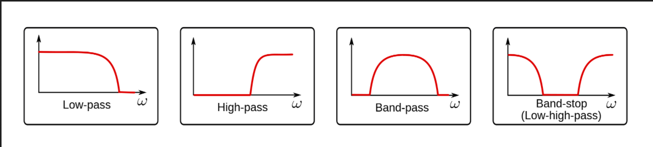
Total 4 types of filters can be generated with a second order Transfer function

Slide 3
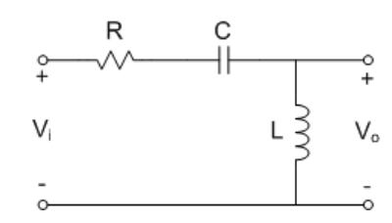
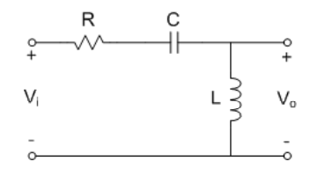
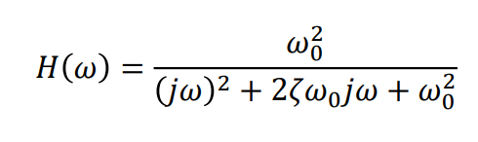
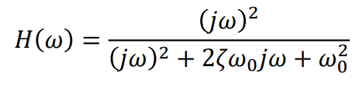
Equations related to all the four types of Filters
In this project I’m using a second order RLC circuit to realize Filters. It indicates that there will be two poles and a maximum of two zeros
Low Pass series RLC Filter
High Pass series RLC Filter

Slide 4
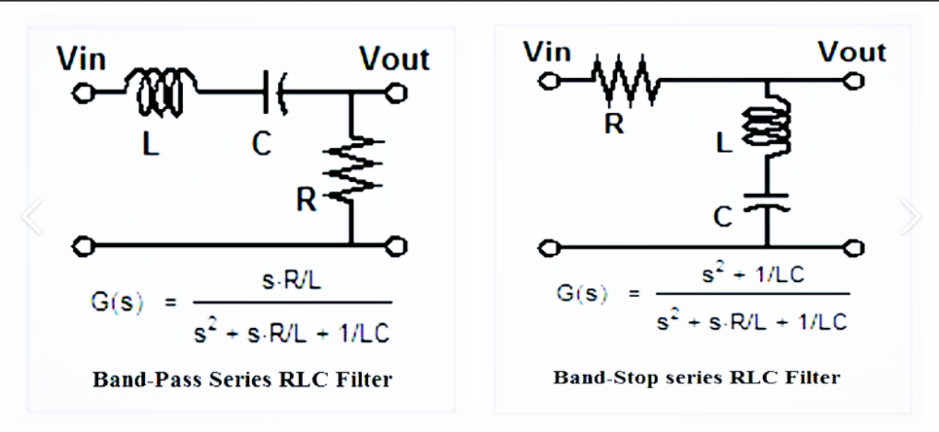

Slide 5
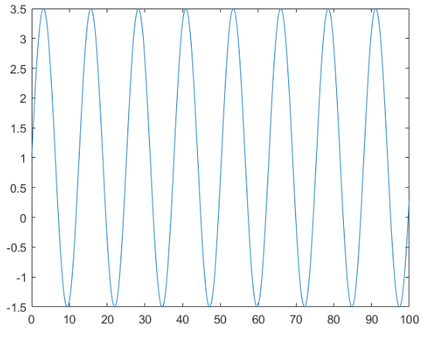
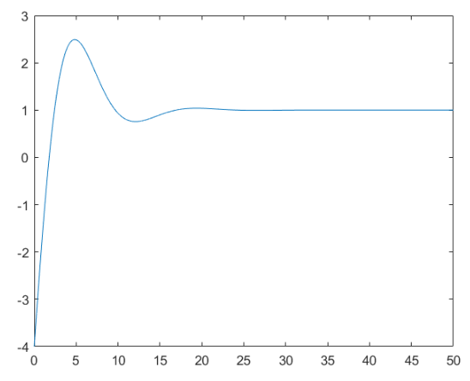
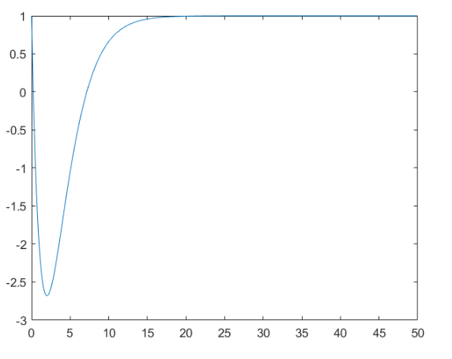
Damping Factor
It measures the rate of decrease of oscillations when the source is removed
D=0
D=0.5
D=1

Slide 6
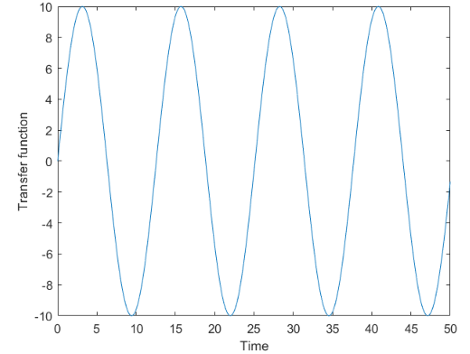
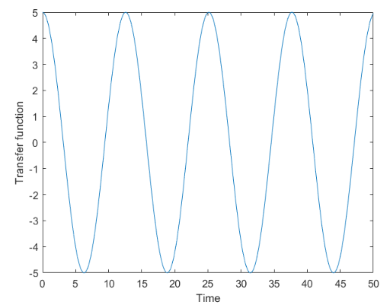
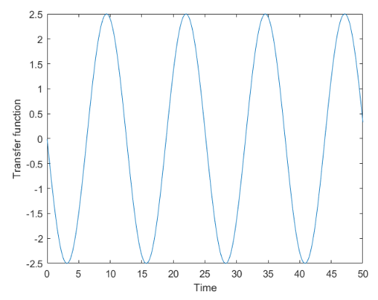
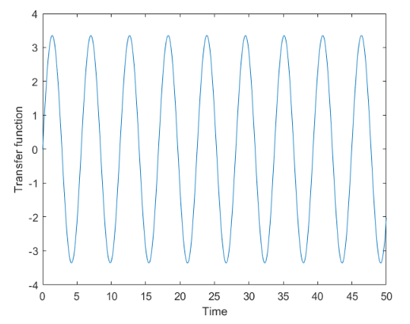
Transfer Function
Low-Pass Filter
Band-Pass Filter
Damping Factor=0
As we can observe from the graphs obtained from the equation.
Damping factor directly defines the nature of the transfer function and for damping factor=0 gives a sinosodial output irrespective of the type of the Filter.
NOTE: This type of Functions are called Undamped
High-Pass Filter
Band-Stop Filter

Slide 7
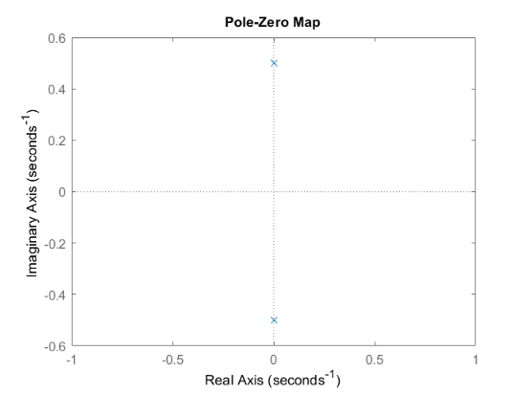
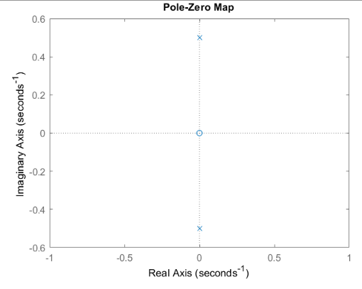
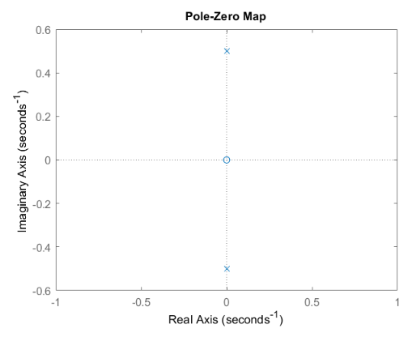
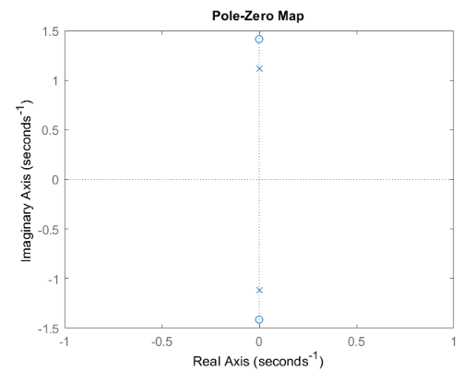
S-Plane
Low-Pass Filter
Band-Pass Filter
Damping Factor=0
As we can observe from the graphs obtained from the equation.
Damping factor directly affects the poles locations and their nature.
In the case of Damping factor=0, both the poles are imaginary in nature.
Zeroes are depended on the numerator, therefore except for Band-Stop, zeroes are always real in nature. Band-Stop may or may not be purely real.
High-Pass Filter
Band-Stop Filter

Slide 8
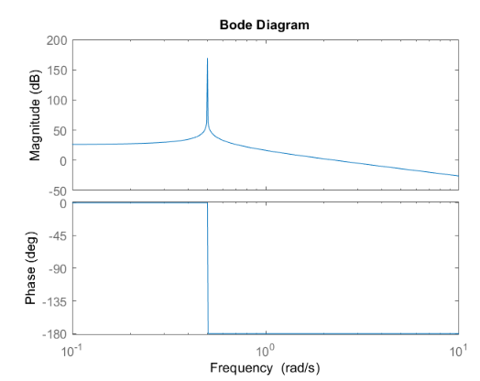
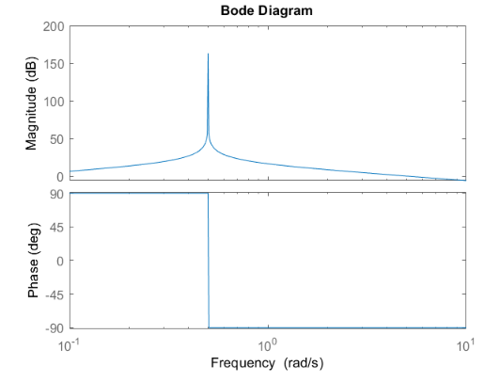
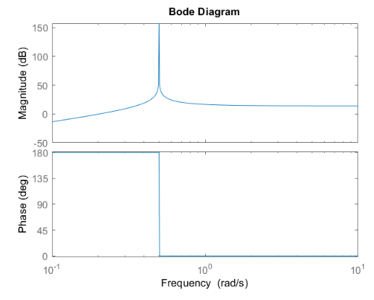
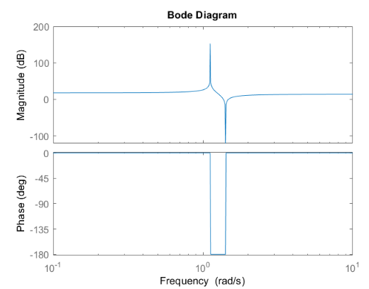
Bode-Plot
Low-Pass Filter
Band-Pass Filter
Damping Factor=0
As we can observe from the graphs obtained from the equation.
When magnitude is near to 0 then those frequencies are rejected since the final outcome is in the form (approx. 0) x input, thereby giving an output of near zero.
Damping factor induces a peak at the selected frequency before moving with its selected nature.
NOTE: In these cases I have chosen a gain of magnitude 5.
High-Pass Filter
Band-Stop Filter

Slide 9
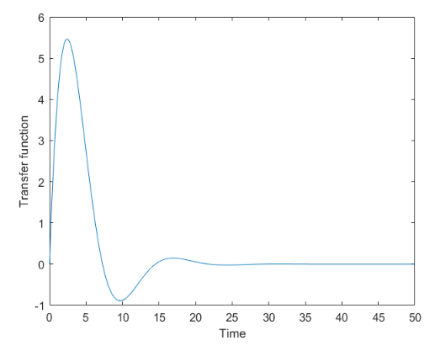
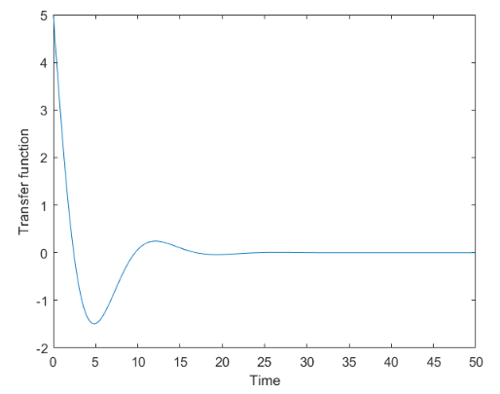
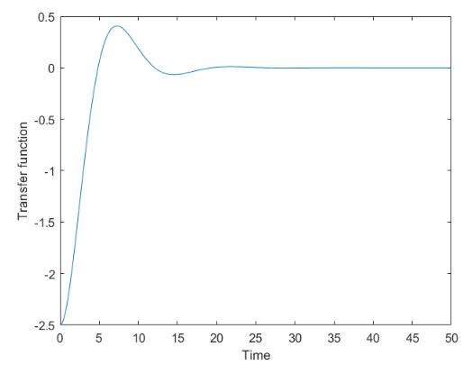
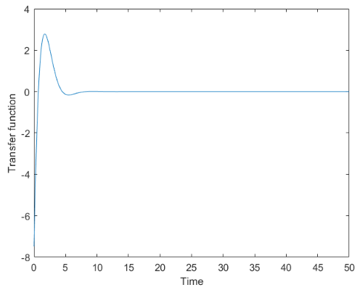
Transfer Function
Low-Pass Filter
Band-Pass Filter
Damping Factor=0.5
As we can observe from the graphs obtained from the equation.
Damping factor directly defines the nature of the transfer function and for damping factor=0.5 gives a sinosodial output which degrades with time irrespective of the type of the Filter.
NOTE: This type of Functions are called Under damped
High-Pass Filter
Band-Stop Filter

Slide 10
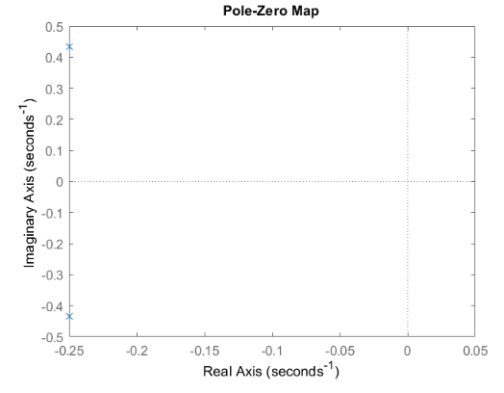
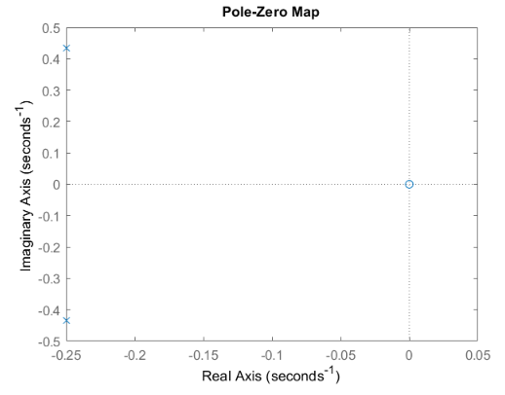
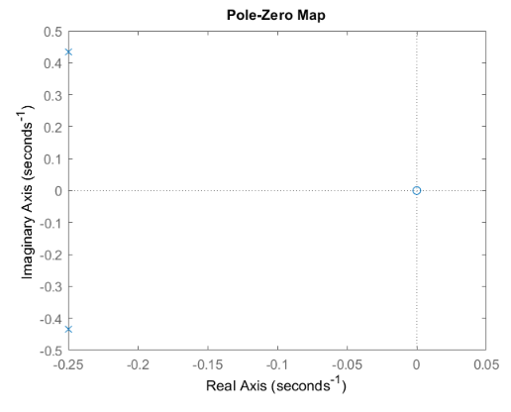
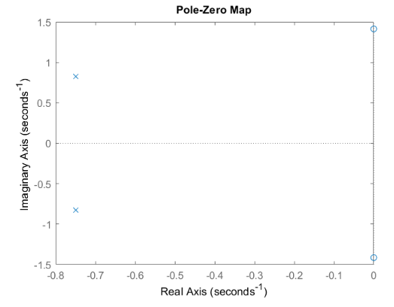
S-Plane
Low-Pass Filter
Band-Pass Filter
Damping Factor=0.5
As we can observe from the graphs obtained from the equation.
Damping factor directly affects the poles locations and their nature.
In the case of Damping factor=0.5, both the poles contain both real and imaginary parts.
Zeroes are depended on the numerator, therefore except for Band-Stop, zeroes are always real in nature. Band-Stop may or may not be purely real.
High-Pass Filter
Band-Stop Filter

Slide 11
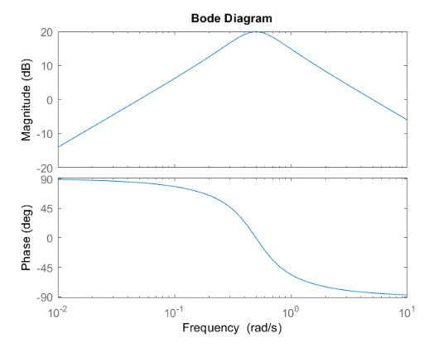
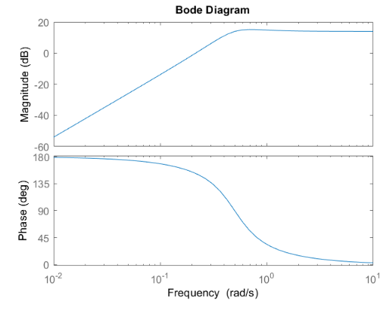
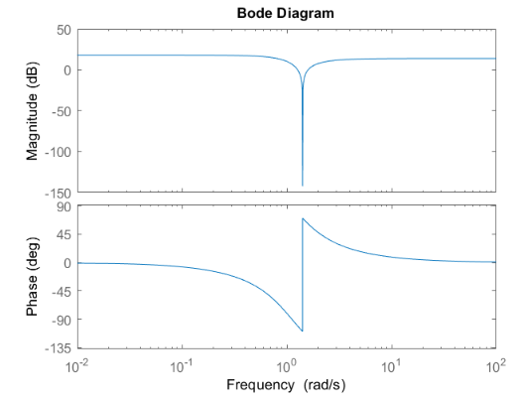
Bode-Plot
Low-Pass Filter
Band-Pass Filter
Damping Factor=0.5
As we can observe from the graphs obtained from the equation.
When magnitude is less than or equal to 0 then those frequencies are rejected.
NOTE: In these cases I have chosen a gain of magnitude 5.
High-Pass Filter
Band-Stop Filter

Slide 12
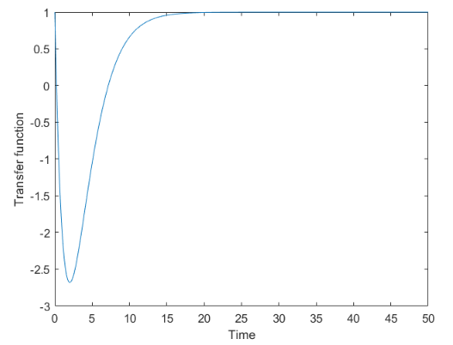
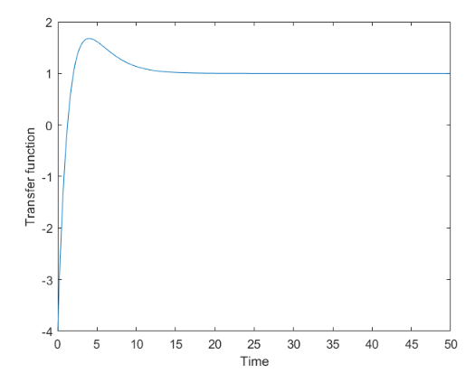
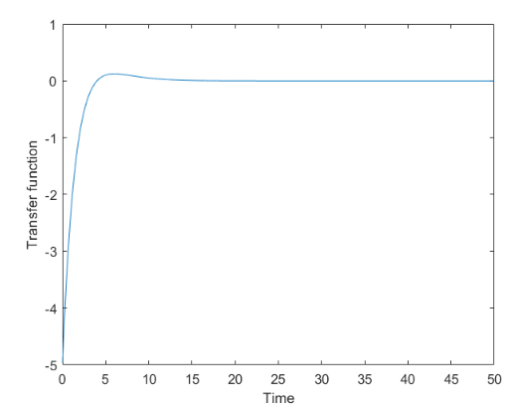
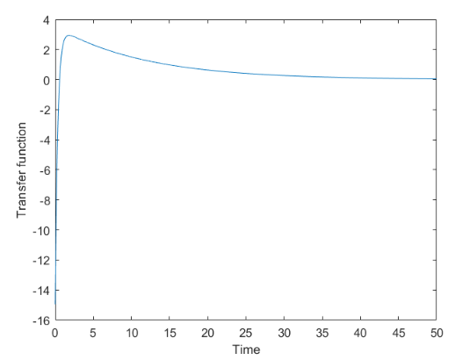
Transfer Function
Low-Pass Filter
Band-Pass Filter
Damping Factor=1
As we can observe from the graphs obtained from the equation.
Damping factor directly defines the nature of the transfer function and for damping factor=1 gives an exponential output which degrades with time irrespective of the type of the Filter.
NOTE: This type of Functions are called Critically damped
High-Pass Filter
Band-Stop Filter

Slide 13
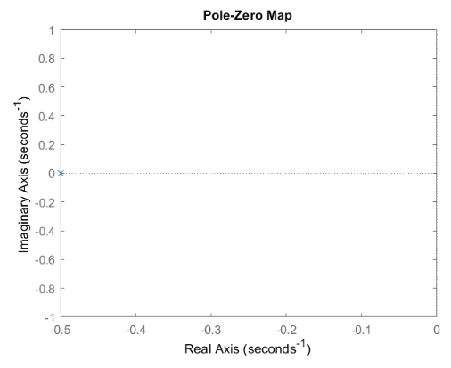
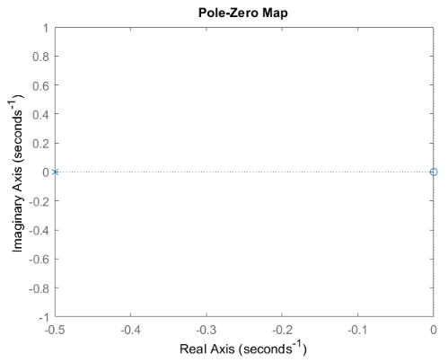
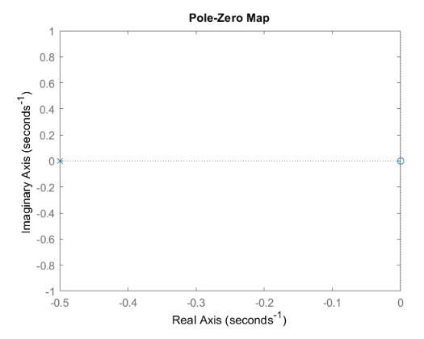
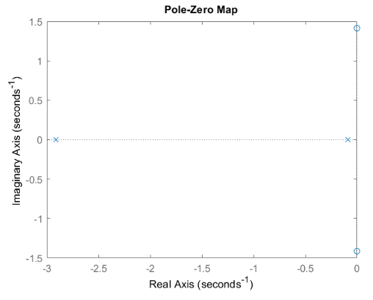
S-Plane
Low-Pass Filter
Band-Pass Filter
Damping Factor=1
As we can observe from the graphs obtained from the equation.
Damping factor directly affects the poles locations and their nature.
In the case of Damping factor=1, both the poles contain real parts.
NOTE: From this point onwards poles cease to exist in imaginary axis.
High-Pass Filter
Band-Stop Filter

Slide 14
Bode-Plot
Low-Pass Filter
Band-Pass Filter
Damping Factor=1
As we can observe from the graphs obtained from the equation.
When magnitude is less than or equal to 0 then those frequencies are rejected.
NOTE: In these cases I have chosen a gain of magnitude 5.
High-Pass Filter
Band-Stop Filter

Slide 15
Transfer Function
Low-Pass Filter
Band-Pass Filter
Damping Factor=1.5
As we can observe from the graphs obtained from the equation.
Damping factor directly defines the nature of the transfer function and for damping factor=1 gives an exponential output which degrades with time irrespective of the type of the Filter.
NOTE: This type of Functions are called Critically damped
High-Pass Filter
Band-Stop Filter

Slide 16
S-Plane
Low-Pass Filter
Band-Pass Filter
Damping Factor=1.5
As we can observe from the graphs obtained from the equation.
Damping factor directly affects the poles locations and their nature.
In the case of Damping factor=1.5, both the poles are real.
Zeroes are depended on the numerator, therefore except for Band-Stop, zeroes are always real in nature. Band-Stop may or may not be purely real.
High-Pass Filter
Band-Stop Filter

Slide 17
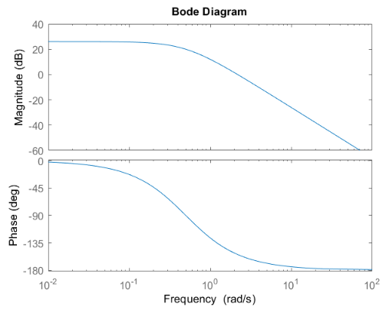
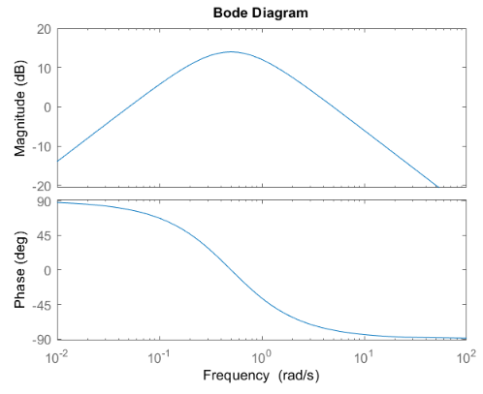
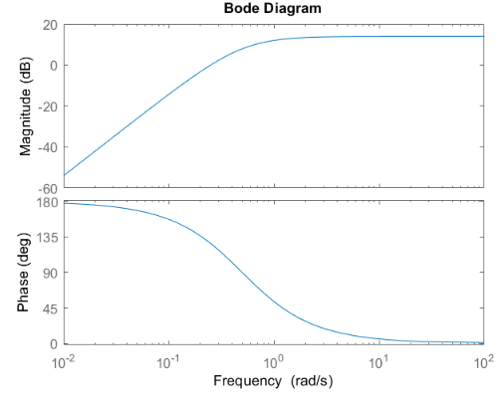
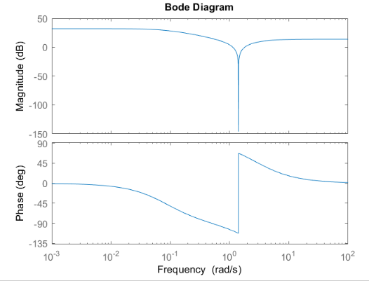
Bode-Plot
Low-Pass Filter
Band-Pass Filter
Damping Factor=1.5
As we can observe from the graphs obtained from the equation.
When magnitude is less than or equal to 0 then those frequencies are rejected.
NOTE: In these cases I have chosen a gain of magnitude 5.
High-Pass Filter
Band-Stop Filter

Slide 18
Damping Factor
 | 0 (UNDAMPED) | 0.5 (UNDER DAMPED) | 1 (CRITICALLY DAMPED) | 1.5 (OVER DAMPED)
Low-Pass | TF(Transfer Function) is sinosodial No zeroes required and present Two imaginary poles are present Phase change is -180 to 0 | TF starts as a sine and slowly tuns into exponential No zeroes required and present Two imaginary poles are present Phase change is -180 to 0 | TF is exponential No zeroes required and present Two imaginary poles are present Phase change is -180 to 0 | TF is exponential No zeroes required and present Two imaginary poles are present Phase change is -180 to 0
High-Pass | TF is sinosodial Two overlapping zeroes are present Two imaginary poles are present Phase change is 0 to 180 | TF starts as a sine and slowly tuns into exponential Two overlapping zeroes are present Two imaginary poles are present Phase change is 0 to 180 | TF is exponential Two overlapping zeroes are present Two imaginary poles are present Phase change is 0 to 180 | TF is exponential Two overlapping zeroes are present Two imaginary poles are present Phase change is 0 to 180
Band-Pass | TF is sinosodial Two non-overlapping zeroes are present Two imaginary poles are present Phase change is -90 to 90 | TF starts as a sine and slowly tuns into exponential Two non-overlapping zeroes are present Two imaginary poles are present Phase change is -90 to 90 | TF is exponential Two non-overlapping zeroes are present Two imaginary poles are present Phase change is -90 to 90 | TF is exponential Two non-overlapping zeroes are present Two imaginary poles are present Phase change is -90 to 90
Band-Stop | TF is sinosodial Two non-overlapping imaginary zeroes are present Two imaginary poles are present Phase change is -135 to 45 | TF starts as a sine and slowly tuns into exponential Two non-overlapping imaginary zeroes are present Two imaginary poles are present Phase change is -135 to 45 | TF is exponential Two non-overlapping imaginary zeroes are present Two imaginary poles are present Phase change is -135 to 45 | TF is exponential Two non-overlapping imaginary zeroes are present Two imaginary poles are present Phase change is -135 to 45
Filters

Slide 19
Thank You

